Slide 1
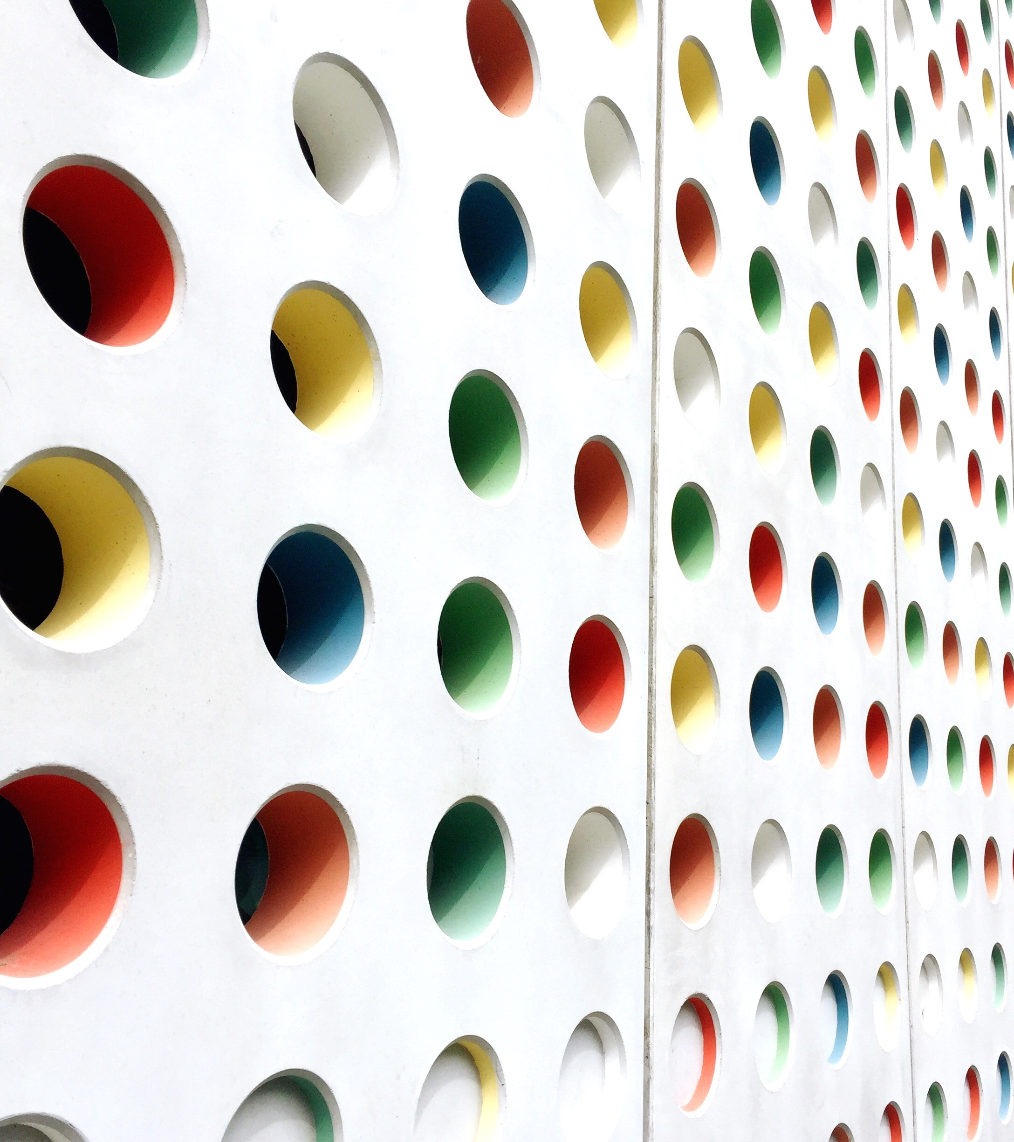
عالم القراءة
Created by :
Mootez chihi
Med. Aziz ben hmida

Slide 2
Introduction
Our site is made for kids who want to read short stories in Arabic and send their feedback
Our aim is to improve the level of reading for Arabic and non-Arabic kids and attract them from a young age. It also includes a parental control so the parents can check on the progress of their kids.

Slide 3

Technologies used:

Slide 4
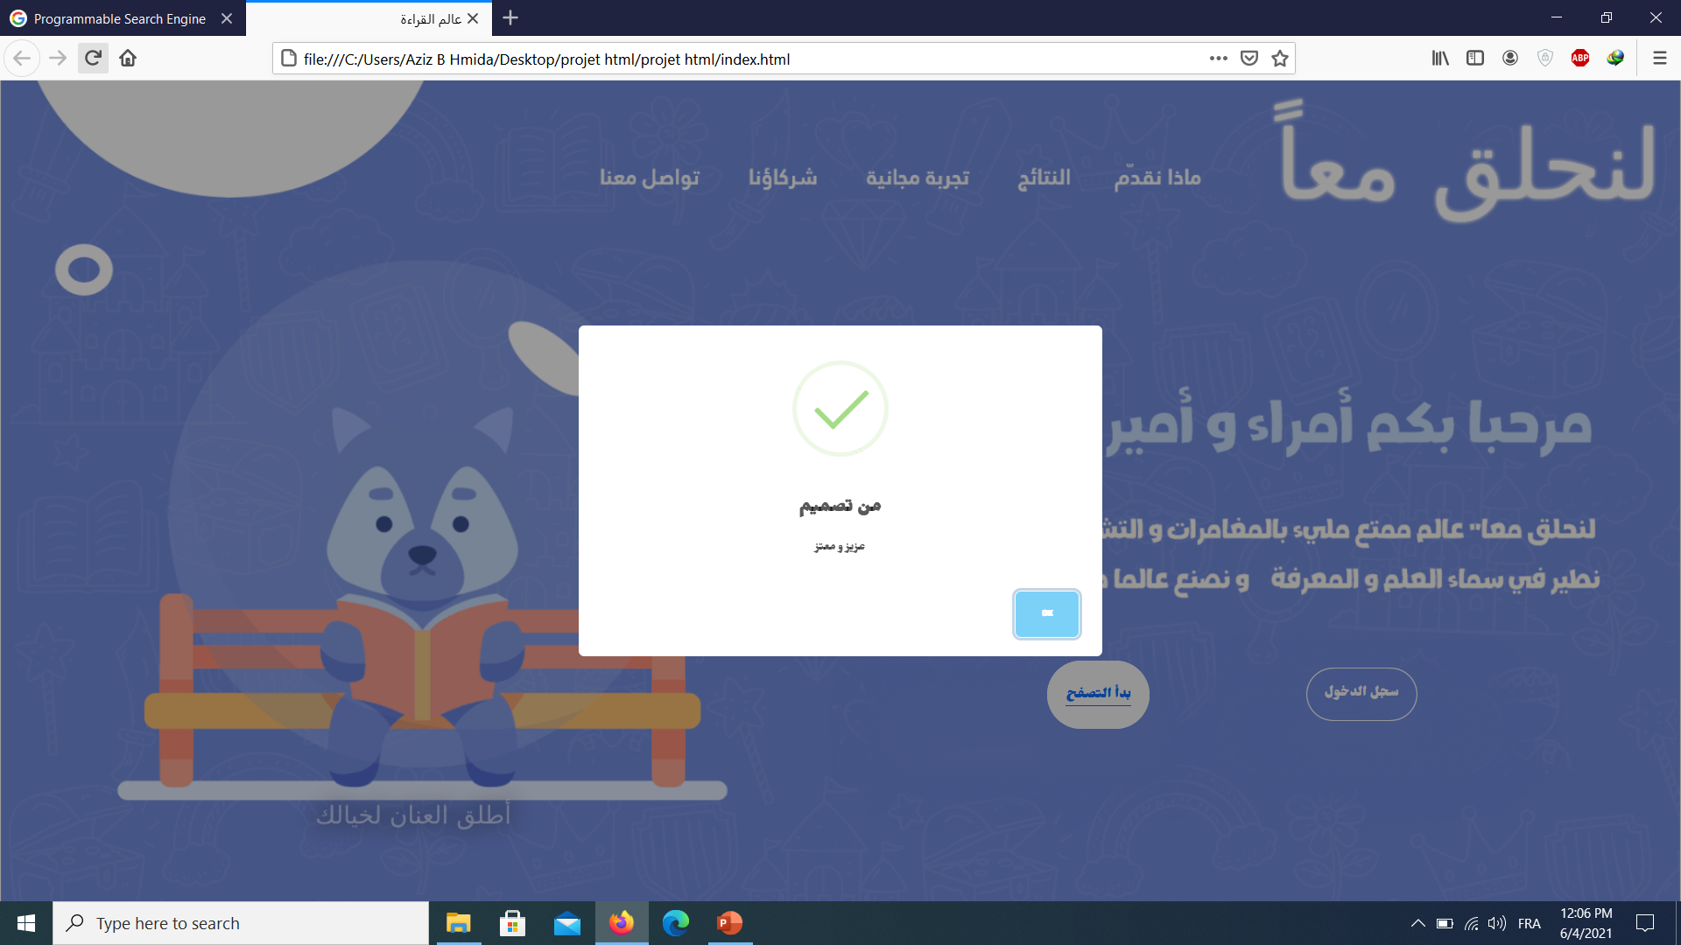

Slide 5
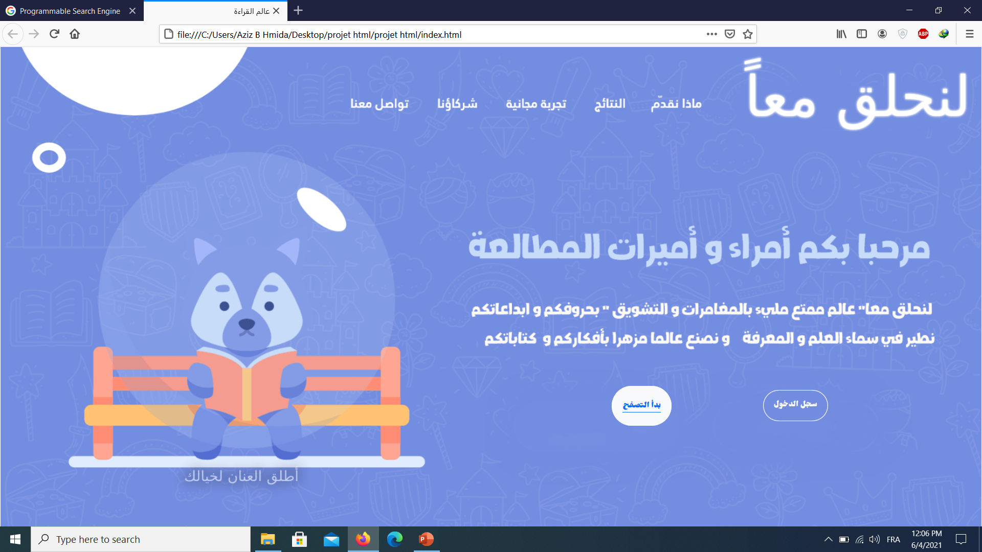

Slide 6
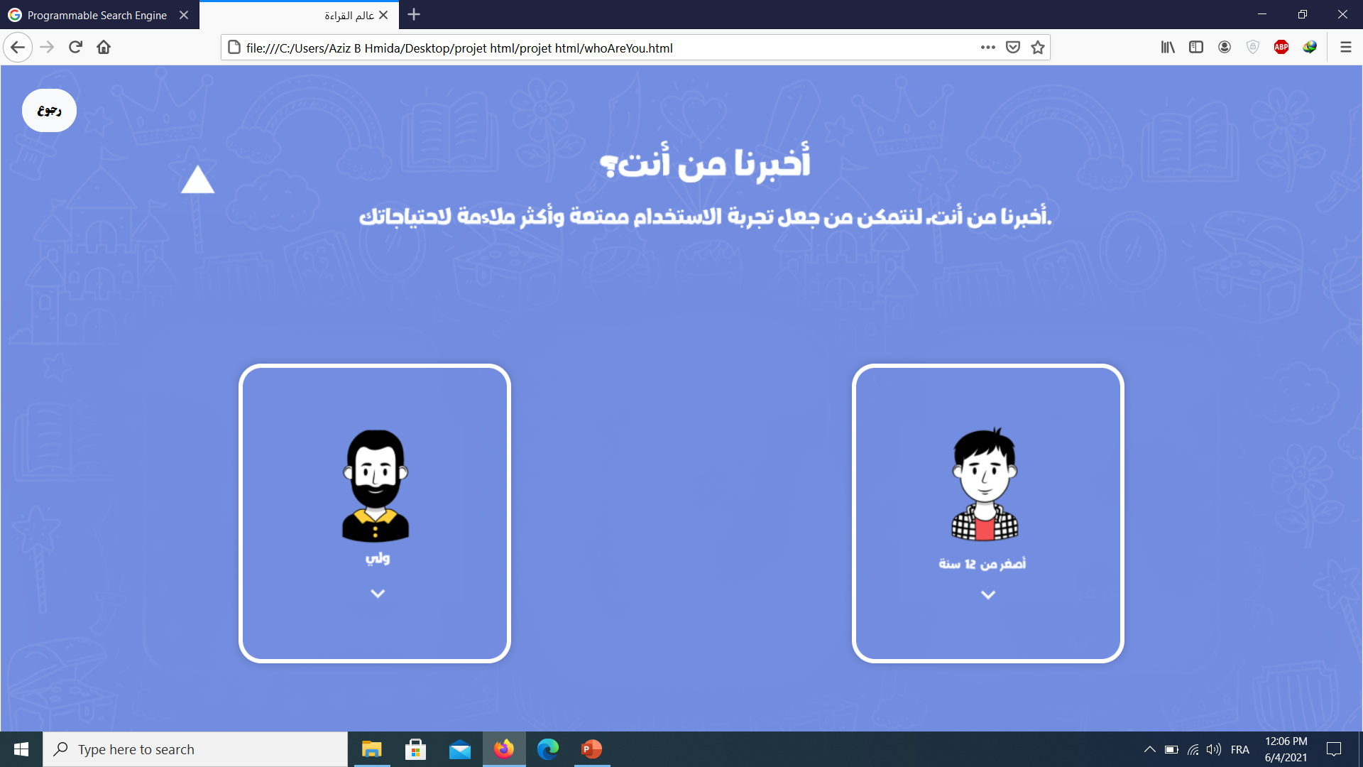

Slide 7
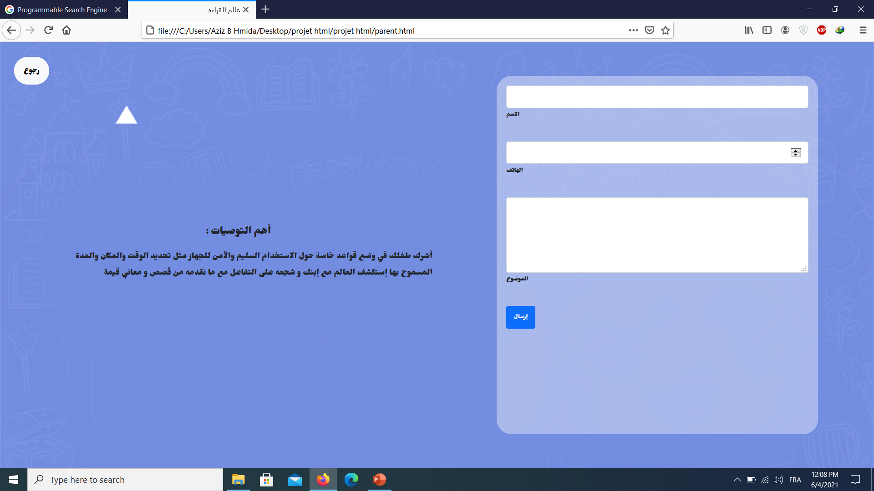

Slide 9
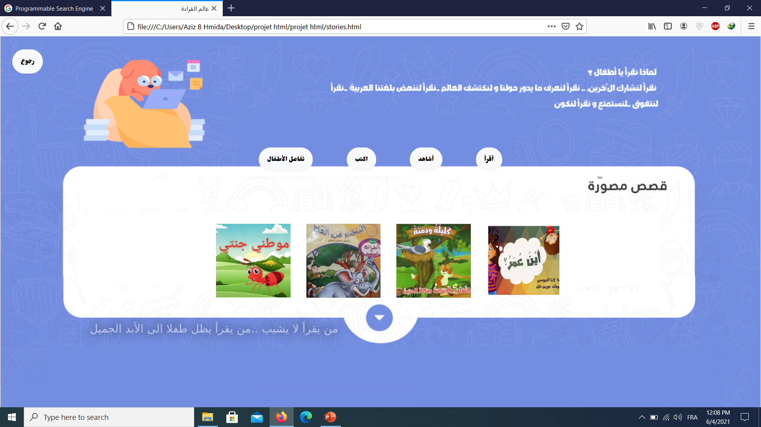

Slide 10
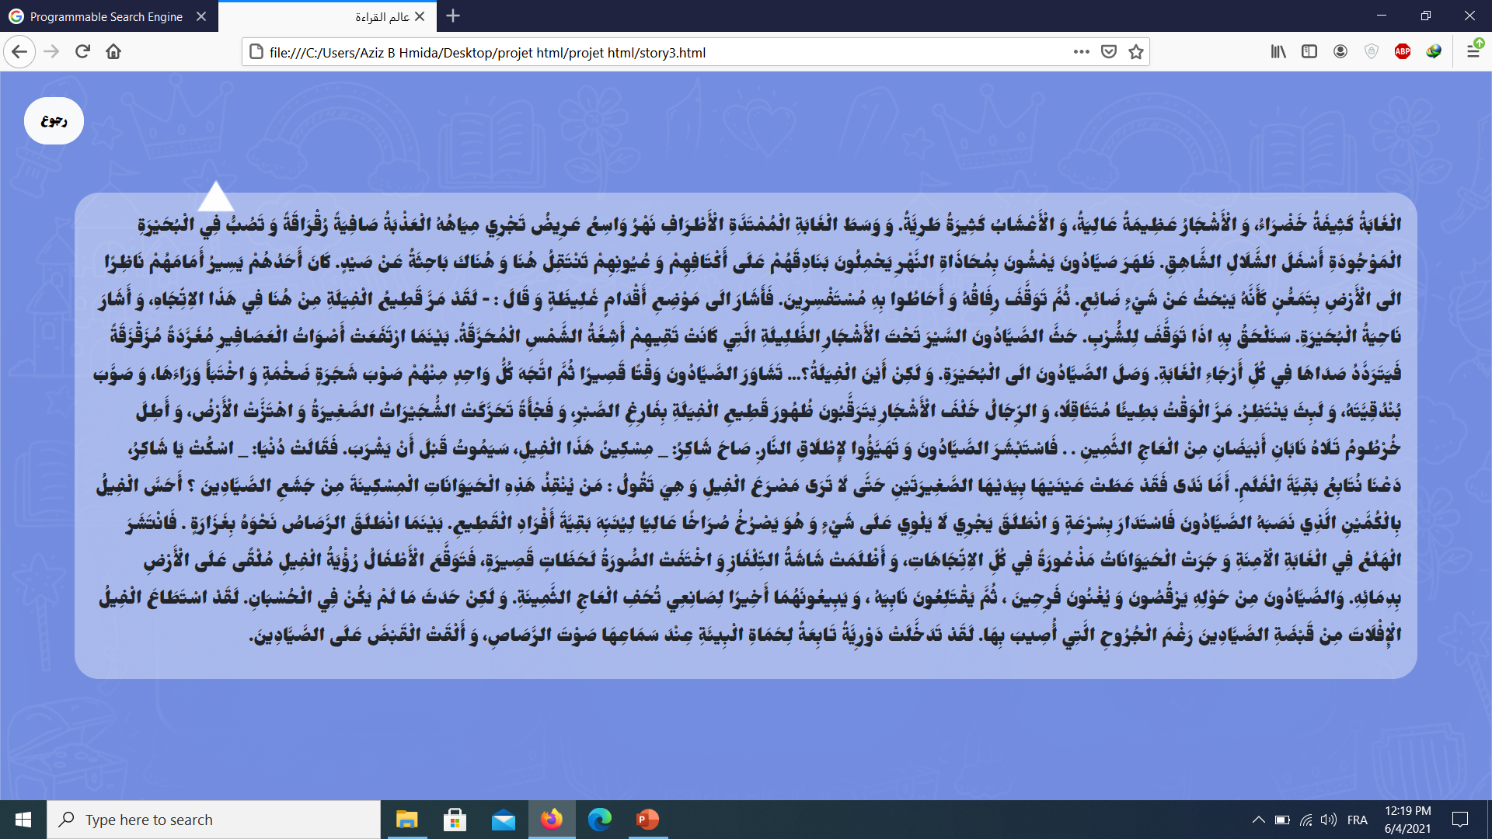

Slide 11
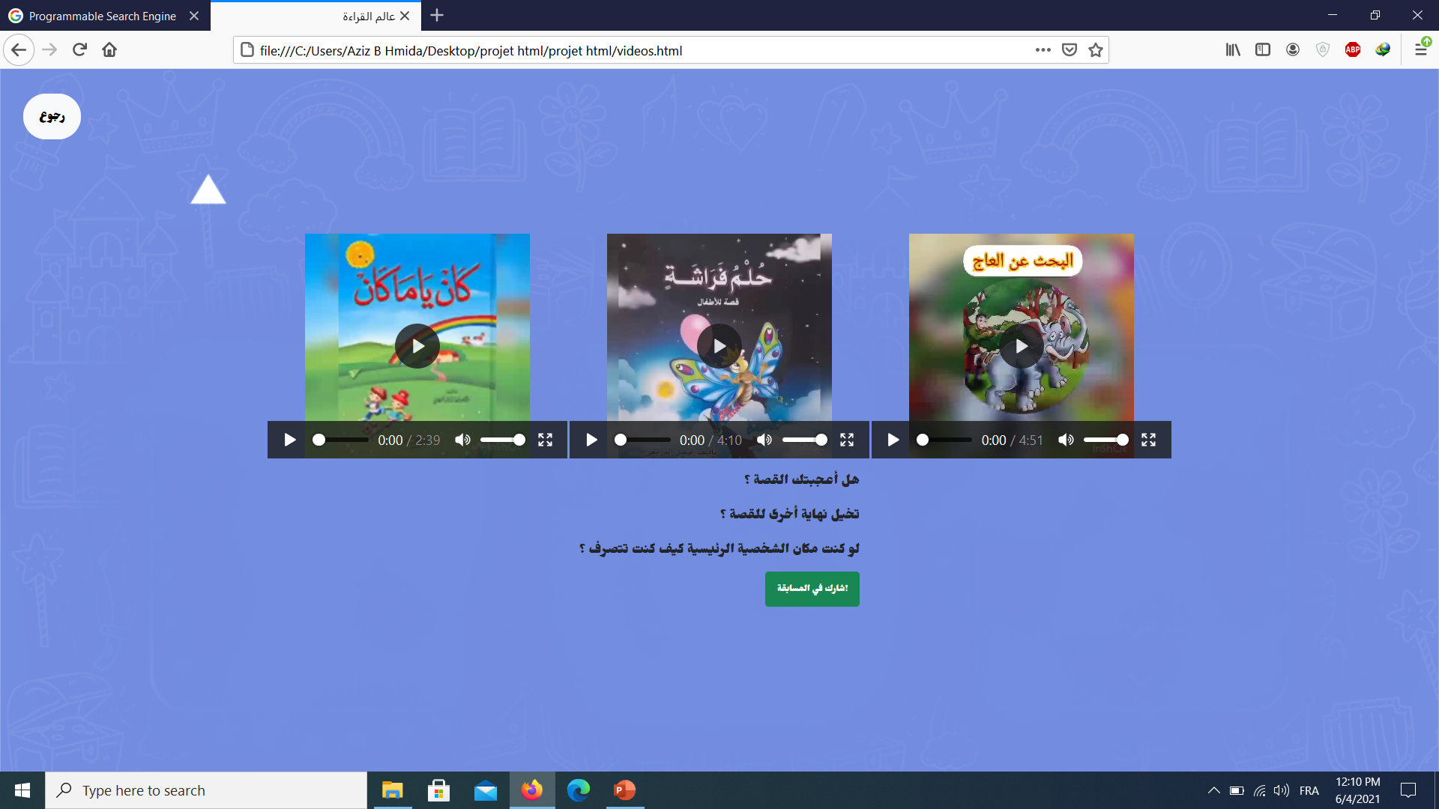

Slide 12
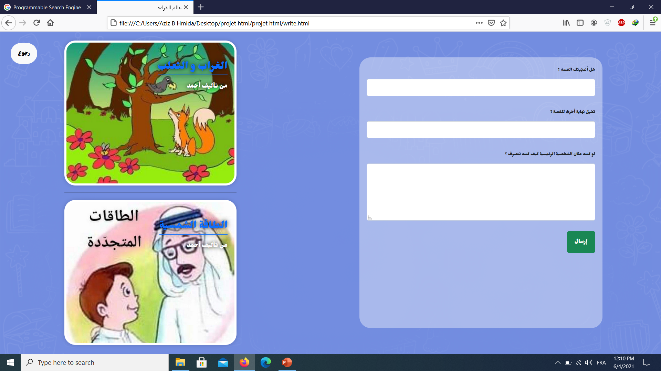

Slide 13
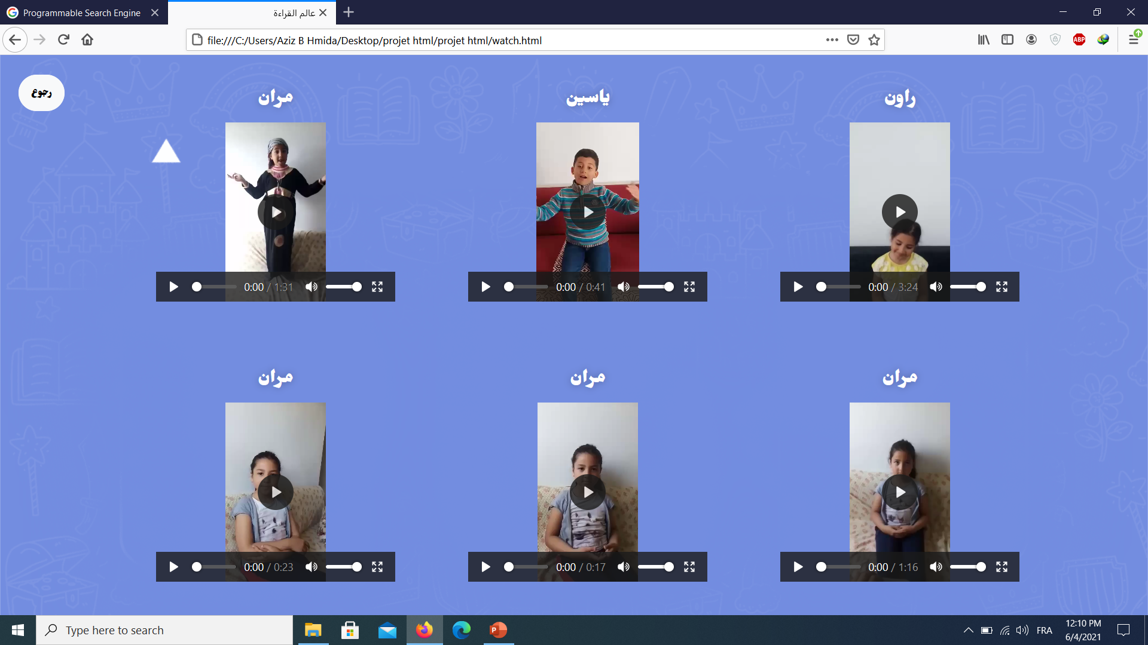

Slide 14
Thank you for your kind attention. We hope you liked our presentation.

